Slide 1



Honeypot
A Trap for Attackers
Dr. Arshad Farhad

Slide 2
Content:
What is deception technology?
Honeypot
Classification of honeypots
Advantages and disadvantages
Honeynets.

Slide 3
Deception Technology
Deception technology is a cybersecurity approach that involves creating traps or decoys to mislead and detect attackers within a network or system.
The goal is proactively identifying potential threats by confusing and diverting attackers away from real assets.
Deception technology includes deploying fake servers, networks, or data resources that appear genuine but are designed to expose malicious actors.
Key aspects of deception technology:
Decoys: Fake systems, files, or networks are strategically placed within an organization's infrastructure to deceive attackers.
Traps: Deceptive elements are set up to trigger alerts or responses when accessed or tampered with, providing early warnings of potential cyber threats.
Detection: By closely monitoring and analyzing the interactions with the decoys, security teams can identify abnormal behavior indicative of an unauthorized presence or malicious activity.

Slide 4
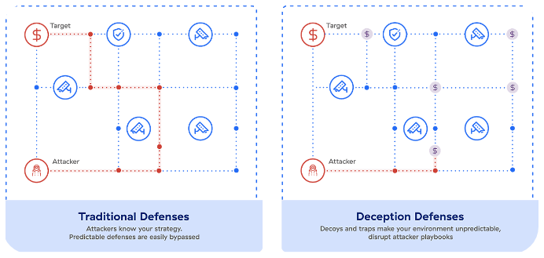
Deception Technology

Slide 5
Deception Technology
Deception
Technology
Honeypots and Honeynets
Classification
Level of Interaction
By implementation
By purpose
Low
High
Physical
Virtual
Research
Production

Slide 6
Honeypot: Introduction
A honeypot is an open or otherwise intentionally vulnerable decoy technology designed to misdirect cyber attacks from critical IT systems. It mimics those systems and provides fabricated files (fake credentials) and data.
Moreover, a honeypot is a computer system that helps IT security experts to observe and learn from cybercriminals’ attacks by observing them in real time.
It helps organizations detect unauthorized use or access to systems.
It also helps them gain crucial information about attackers and how they operate.
Any access to a honeypot triggers monitoring and event logging
It may comprise several components, such as:
Network devices,
Keyloggers,
Monitoring tools,
Packet analyzers, and
Alerting tools.

Slide 7
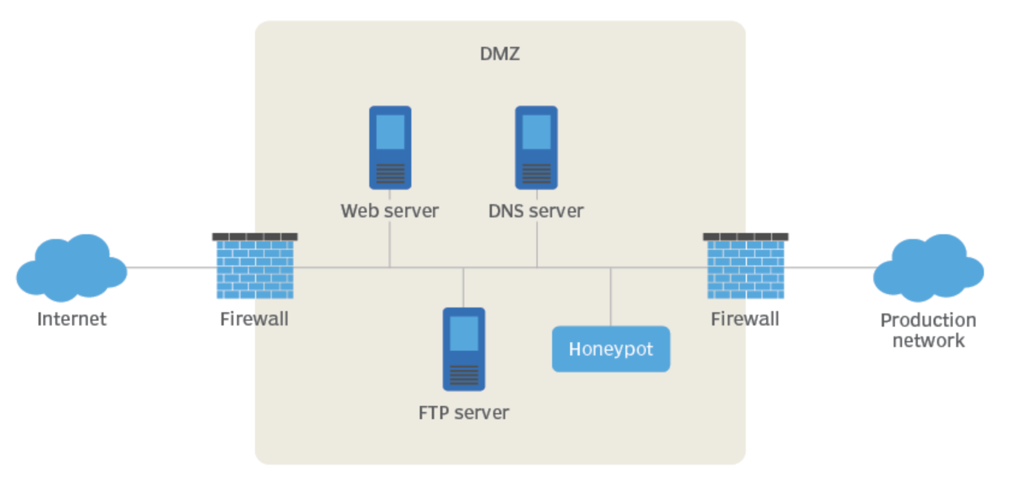
What is a Honey Pot?
A Honeypot is an intrusion detection technique used to study hackers movements

Slide 8
What is a Honey Pot?(cont.)
A virtual machine that sits on a network or a client
Goals
Should look as real as possible!
Should be monitored to see if it is being used to launch a massive attack on other systems
Should include files that are of interest to the hacker, e.g., fake credentials

Slide 9
Key Use Cases: Early Detection and Analysis
Goals
Identify emerging threats: Discover new attack methods and tools before they target production systems.
Track attacker behavior: Understand attacker motivations, targets, and methodologies.
Analyze attack patterns: Identify trends and patterns to predict and prevent future attacks.

Slide 10
Key Use Cases: Threat Intelligence Gathering
Goals
Collect valuable data: Gather malware samples, attacker tools, exploits, and potential attacker identities.
Inform security strategies: Update security tools, prioritize vulnerabilities, and develop targeted defenses.
Support incident response: Aid in identifying the scope and origin of attacks for swifter response.
An exploit is a piece of software, a chunk of data, or a sequence of commands that takes advantage of a bug or vulnerability to cause unintended or unanticipated behavior to occur on computer software.
Includes: gaining control of a computer system, allowing privilege escalation, or a denial-of-service (DoS or related DDoS) attack.

Slide 11
Key Use Cases: Deception and Distraction
Goals
Divert attackers from real systems: Act as decoys to protect critical infrastructure and sensitive data (Deception).
Waste attacker resources: Engage attackers in the honeypot, buying time for security teams to prepare.
Disrupt attack chains: Delay or misdirect attackers to hinder their progress and prevent breaches.
Obfuscation: Implementing measures to hide critical information, making it more difficult for attackers to understand the system's architecture.
Traffic Shaping: Controlling and manipulating network traffic (e.g., bandwidth allocation) to slow down the attackers' movement within the network.
Time-Based Access Controls: Limiting the timeframe during which certain actions can be performed, hindering (making it difficult) the speed at which attackers can move laterally.

Slide 12
Key Use Cases: Security Testing and Research
Goals
Evaluate security controls: Test the effectiveness of existing tools and policies against real-world attacks.
Identify system vulnerabilities: Discover unknown weaknesses and prioritize patching efforts.
Develop and test security tools: Provide a safe environment for research and development.

Slide 13
Specific Applications
Financial institutions: Combat financial fraud and data breaches.
Government and military: Secure critical infrastructure and classified information.
Industrial control systems: Prevent disruption of critical operations.
Software development: Test applications for security vulnerabilities.

Slide 14
Classification
By level of interaction
High
Low
By Implementation
Virtual
Physical
By purpose
Production
Research
Classification
Level of Interaction
By implementation
By purpose
Low
High
Physical
Virtual
Research
Production

Slide 15
Interaction: Low interaction Honeypots
Simulated systems that emulate services and vulnerabilities to attract and identify attackers without exposing the organization to real risks.
They have limited interaction; they normally work by emulating services and operating systems.
They simulate only services that cannot be exploited to get complete access to the honeypot.
Attacker activity is limited to the level of emulation by the honeypot.
Examples of low-interaction honeypots include Specter, Honeyd, and Kfsensor.

Slide 16
Low-interaction honeypots: Specter
SPECTER is a smart honeypot or deception system.
It simulates a complete machine, providing an interesting target to lure hackers away from the production machines.
SPECTER offers common Internet services such as SMTP, FTP, POP3, HTTP, and TELNET, which appear perfectly normal to the attackers but, in fact, are traps for them to mess around and leave traces without even knowing that they are connected to a decoy system, which does none of the things it appears to do but instead logs everything and notifies the appropriate people.
Furthermore, SPECTER automatically investigates the attackers while they are still trying to break in.
SPECTER provides massive amounts of decoy data, generating decoy programs that will leave hidden marks on the attacker's computer.
http://gabiam.com/software/laura_chapelle/Software/specter/

Slide 17
Low-interaction honeypots: Specter
A SPECTER system consists of a dedicated PC and the SPECTER software.
This usually means to place it as close to the Internet as possible, typically in the DMZ.
But SPECTER can also be installed on internal networks to find out about suspicious activities originating from within an organization.
Another interesting possibility is to install SPECTER on a production machine such as a mail server.
In this scenario, the SMTP service is real, while SPECTER simulates all other network services on the machine.
If an attacker connects to the machine looking for vulnerabilities, he will likely connect to one of the simulated services and find what he is looking for.
But while he thinks he's breaking in, he has actually triggered an alert, he's investigated, everything he does is logged, and at the same time, the mail server is absolutely safe.
http://gabiam.com/software/laura_chapelle/Software/specter/
Notes:
DMZ: is a physical or logical subnet that separates a local area network (LAN) from other untrusted networks

Slide 18
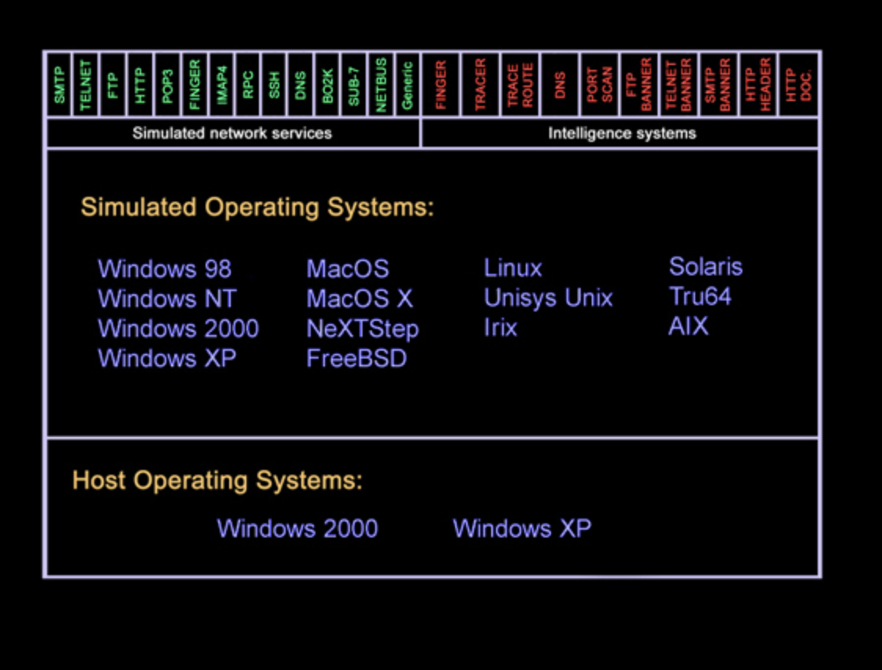
Low-interaction honeypots: Specter
http://gabiam.com/software/laura_chapelle/Software/specter/

Slide 19
Interaction: High interaction Honeypots
More complex and realistic honeypots that allow deeper interaction with attackers. These honeypots can capture detailed information about attacker behavior.
They are usually complex solutions as they involve real operating systems and applications.
Nothing is emulated; the attackers are given the real thing
A high-interaction honeypot can be compromised completely, allowing an adversary to gain full access to the system and use it to launch further network attacks.
Examples of high-interaction honeypots include Symantec Decoy Server and Honeynets.
As the Decoy Server works as a honeypot, it also works as an IDS monitoring the network for signs of intrusion. If an attack is detected, all traffic related to that attack is recorded for later use.

Slide 20
Implementation
Physical
Real machines
Own IP Addresses
Virtual
Simulated by other machines that:
May simulate a lot of (different) virtual honeypots at the same time

Slide 21
Production
Purpose:
The primary purpose of production honeypots is to actively engage and detect malicious activity within a live, operational environment.
They are used to identify and analyze threats that may target an organization's actual systems and services.
Realistic Environment:
Production honeypots mimic genuine systems and services within the organization's network.
They often replicate the characteristics of legitimate assets to attract and engage attackers in a manner that closely mirrors real-world scenarios.
Integration with Security Operations:
Production honeypots are typically integrated with an organization's security operations center (SOC) and incident response processes. This integration ensures that alerts generated by the honeypots are monitored and investigated by cybersecurity professionals.

Slide 22
Research
Research honeypots are complex to deploy and maintain, capture extensive information, and are used primarily by research, military, or government organizations.
Collect compact amounts of high value information
Discover new Tools and Tactics
Understand Motives, Behavior, and Organization

Slide 23
Advantages
Small data sets of high value.
Easier and cheaper to analyze the data
Designed to capture anything thrown at them, including tools or tactics never used before
Require minimal resources
Can collect in-depth information
Conceptually very simple

Slide 24
Disadvantages
Can only track and capture activity that directly interacts with them
All security technologies have risk
Building, configuring, deploying, and maintaining a high-interaction honeypot is time-consuming.
High interaction honeypot introduces a high level of risk
Low-interaction honeypots are easily detectable by skilled attackers

Slide 25
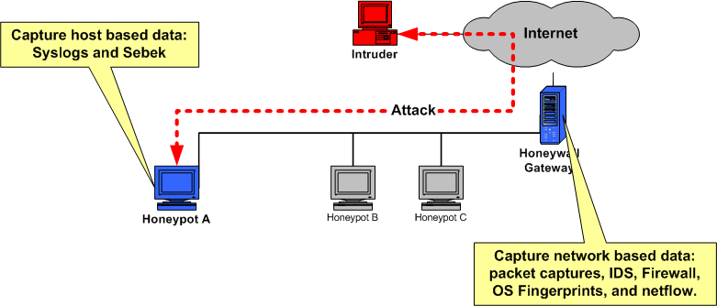
Working of Honeynet – High – interaction honeypot
Honeynet has 3 components:
Data control
Data capture
Data analysis

Slide 26
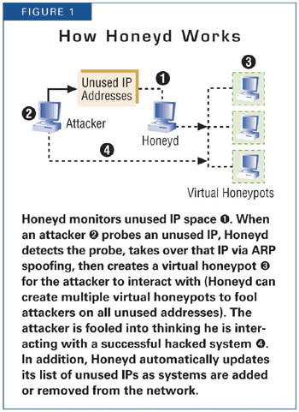
Working of Honeyd – Low – interaction honeypot
Open Source and designed to run on Unix systems
Concept - Monitoring unused IP space

Slide 27
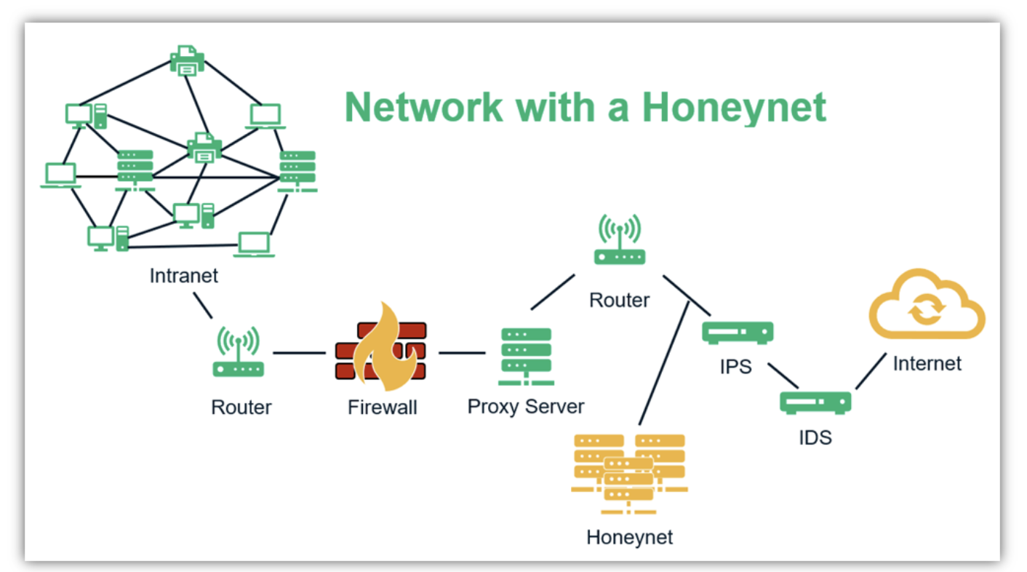
Honeynets
A network of honeypots (honeynet) can be placed in different positions, for example — outside the external firewall, in the DMZ, or within the internal network.
A honeynet has servers, networking devices, and systems similar to a legitimate network with fake data.
Since the purpose is to lure attackers into exploiting intentionally vulnerable systems to monitor and study their activities, placing a honeynet on the internal network is risky unless the attack can be trapped within it.

Slide 28
CONT’D…
However, since more than 75% of security incidents occur due to insider threats, installing a honeypot with proper configurations to monitor user behavior on the internal network is often worth the risk.
A honeypot on the internal network can detect misconfigured firewall settings and be useful in detecting zero-day exploits. All in all, installing honeypots can strengthen your organization’s network security posture significantly.

Slide 29
Conclusion
Not a solution!
Can collect in depth data which no other technology can
Different from others – its value lies in being attacked, probed or compromised
Extremely useful in observing hacker movements and preparing the systems for future attacks

Slide 30

Thank you
Questions

